Slide 1

Create presentations online
with TeamLab Documents
www.teamlab.com

Slide 2
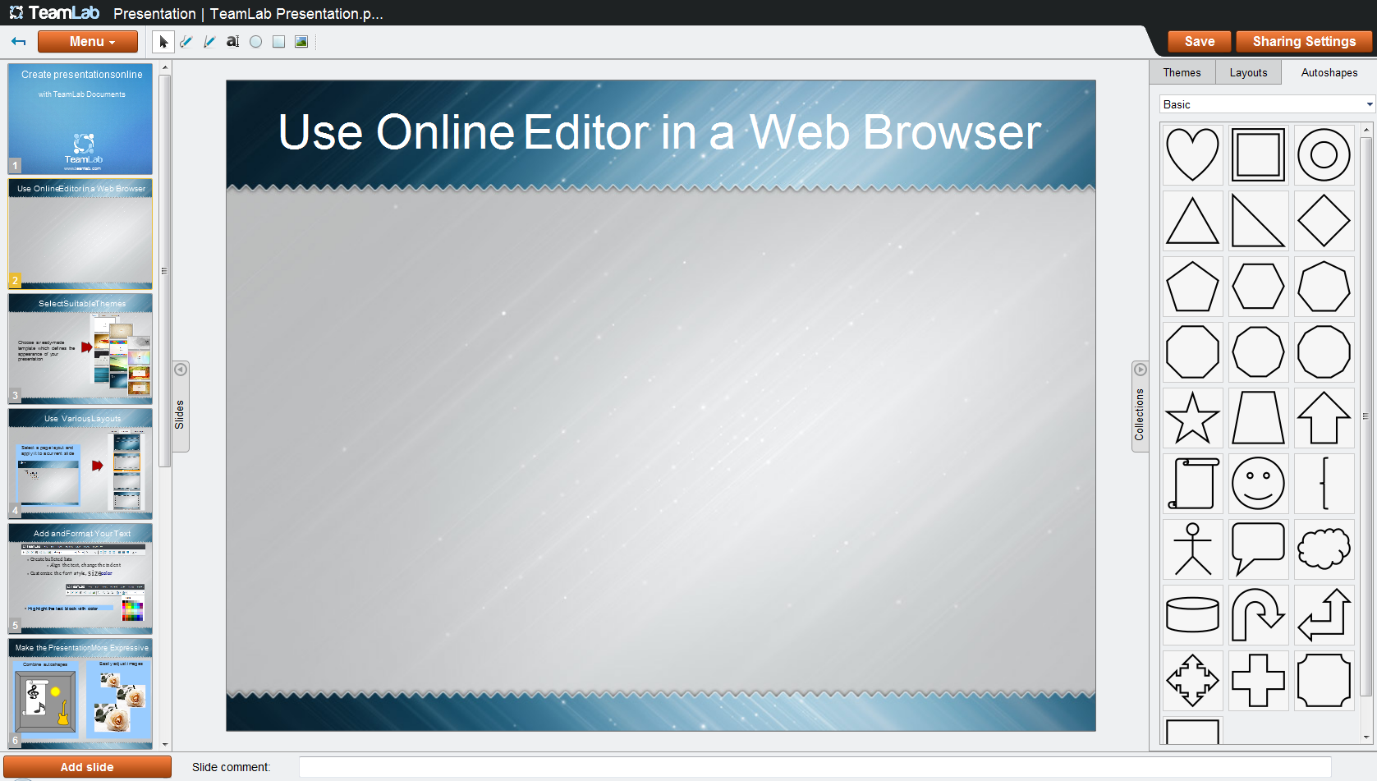
Use Online Editor in a Web Browser
Create and edit presentations right on your TeamLab portal
Use the online editor that includes all the needed tools
Share the presentation with your colleagues

Slide 3
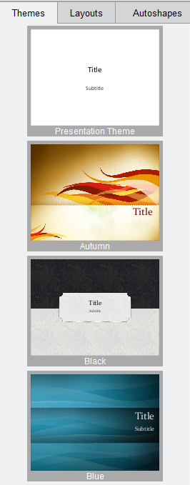
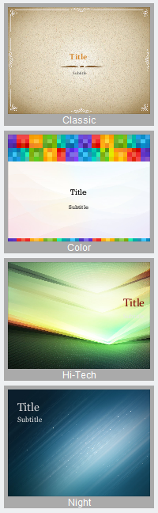
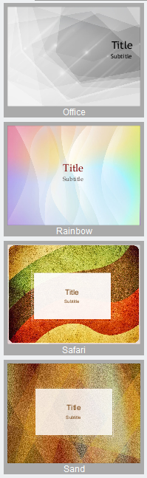
Select Suitable Themes
Choose a ready-made template which defines the appearance of your presentation

Slide 4
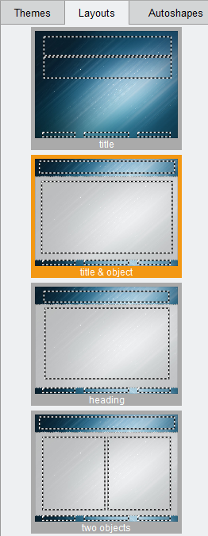
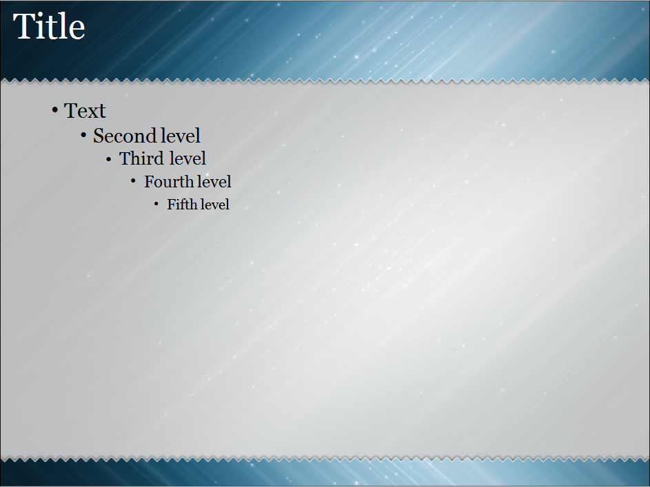
Use Various Layouts
Select a page layout and apply it to a current slide

Slide 5
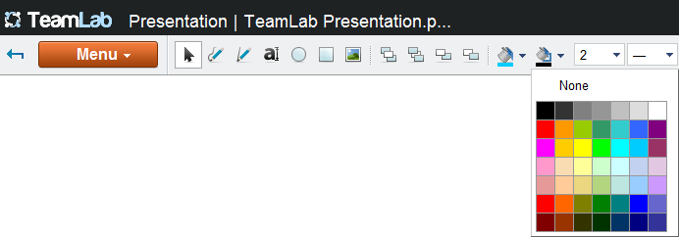
Add and Format Your Text
Create bulleted lists
Align the text, change the indent
Customize the font style, size,color
Highlight the text block with color

Slide 6

Make the Presentation More Expressive
Combine autoshapes
Easily adjust images

Slide 7
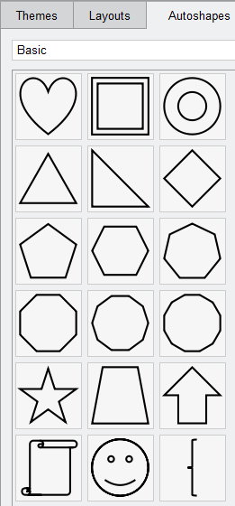
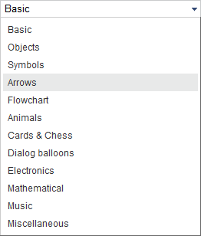

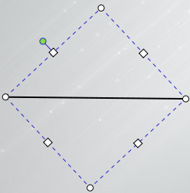
Use Graphic Objects
Apply the autoshapes
of different types
Draw figures and lines

Slide 8
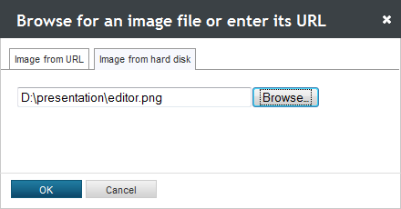

Insert Images
Load image files, adjust their size, position, orientation

Slide 9

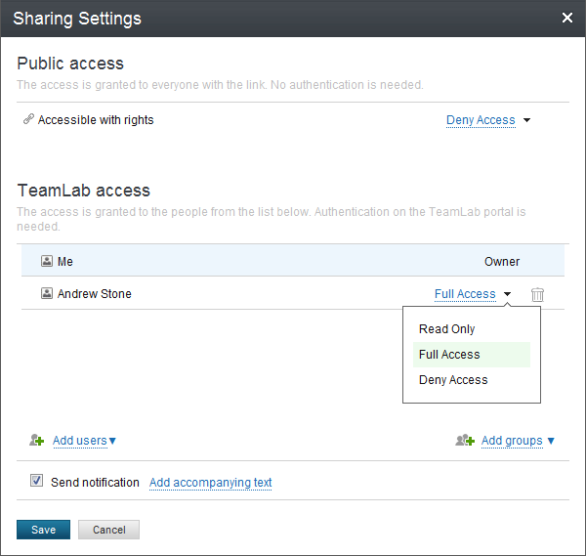
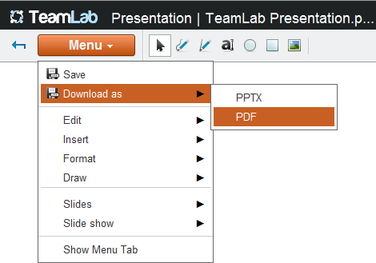
Save and Share Your Work
Save the created presentation on your portal
Share it with other portal users
Select an appropriate access mode
Download the file, if needed

Slide 10


Create Your Own Presentation
with TeamLab Online Office Suite
Learn more at www.teamlab.com/help/GettingStarted/Documents.aspx

